Slide 1
CS 4900 Final Project Presentation: Distributed Imp
Alex Snyder and Robin Kelby

Slide 2
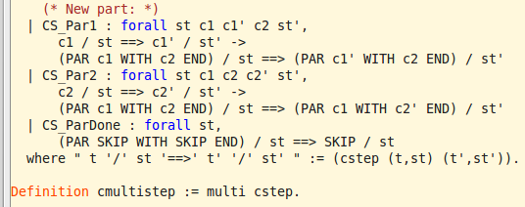
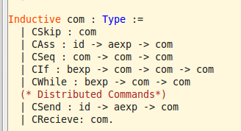
Similarities to Imp and Par Imp
The PAR commands from Smallstep.v were a model for some of our code, in terms of having multiple commands running at once
We added to the base commands from Imp.v
Our distributed system, like Par Imp, is also non-deterministic
Notes:
Briefly introduce what distributed systems are (message passing between machines). Given the students in the class, most probably already know what that is.

Slide 3
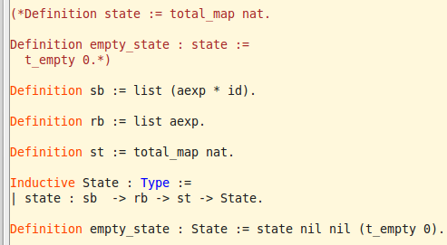
Our Distributed System: Modifications to State
Imp and other imperative languages are based on commands that change the state of a program
To implement send and receive commands, our state needed to now include send and receive buffers, as well as a total_map of nats
Id for machine (imp system)
Data
Notes:
Go over the original state and the changes we made with the send and receive buffers

Slide 4
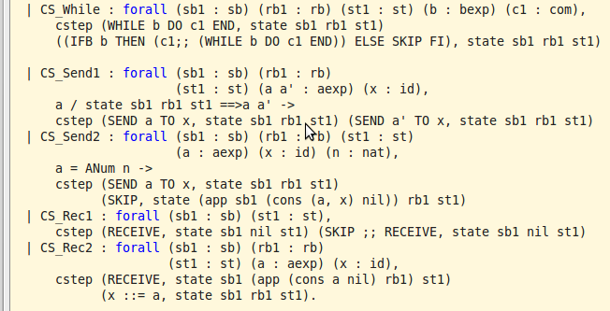
Our Distributed System: cstep Inference Rule Additions
Two Send rules:
CS_Send1 says that if the data can take a step, then the command can take a step
CS_Send2 says that if the data is a value (ANum), then the send buffer is updated
Two Receive rules:
CS_Rec1 adds a SKIP command if the current command is a RECEIVE, but the receive buffer is empty
CS_Rec2 pops the data from the receive buffer
Notes:
Show how the send and receive additions act like a queue for the data/ids

Slide 5
Our Distributed System: Need for dist_imp Inductive Relation
Goal of Our System: Message passing between two computers running Imp commands
cstep relation has rules only for one computer, cannot extract data from the send buffer of one system and move it to the specified computer’s receive buffer
Modeling each computer: encapsulate an id, a set of commands, and a state
Modeling the distributed system: an inductive relation with two computers in a given state stepping to new states
Notes:
Explain our reasoning for how we’ve set up our system

Slide 6
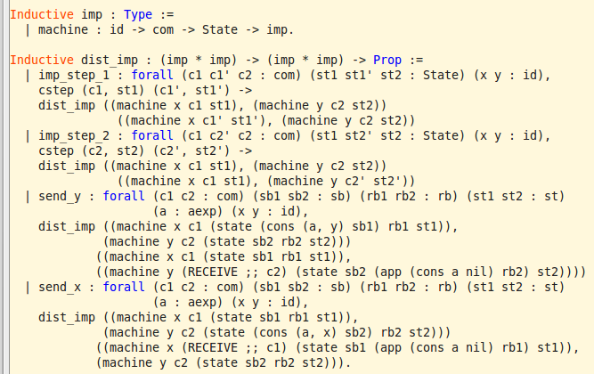
Our Distributed System: dist_imp Inductive Relation
Notes:
Show the 4 rules of the dist_imp inductive relation

Slide 7
Example Thus Far
Notes:
Add screenshots of example and proof once coded

Slide 8
Path Forward
Goals for the rest of the semester:
Test more examples and systems in Coq
Further work that could be done:
Model systems with >2 computers in a distributed system
Different types of data

